Slide 1
Applying Machine Learning to Image Data
Data Science Detroit
Jonathon Smereka
3/30/2017

Slide 2
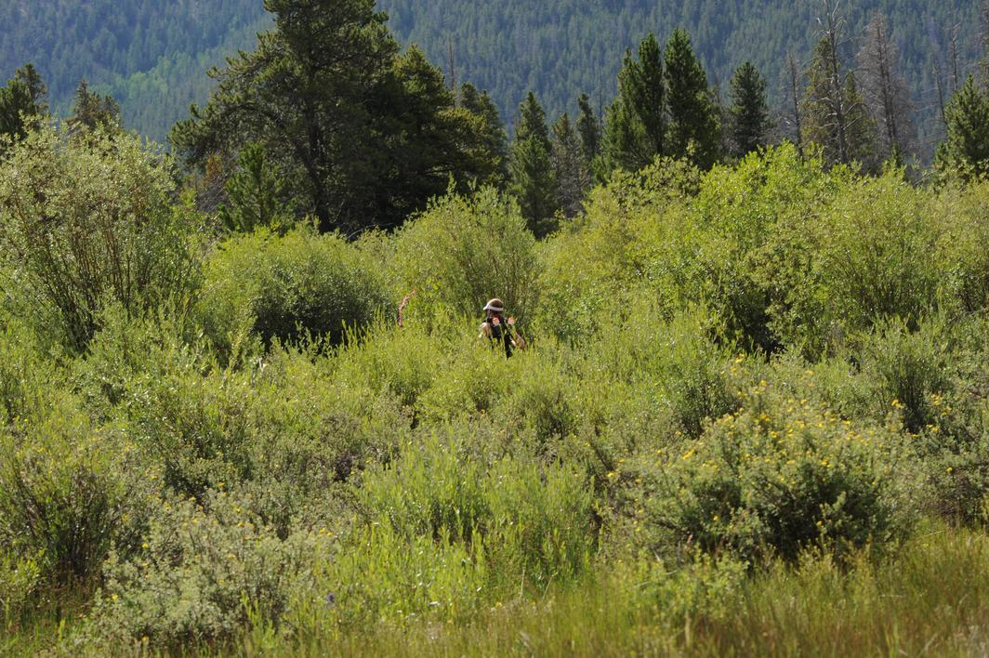
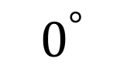
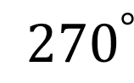
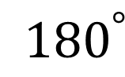
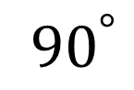
Tonight’s Task: Image Orientation Detection
$${ 0}^{°}$$
$${ 90}^{°}$$
$${ 180}^{°}$$
$${ 270}^{°}$$

Slide 3
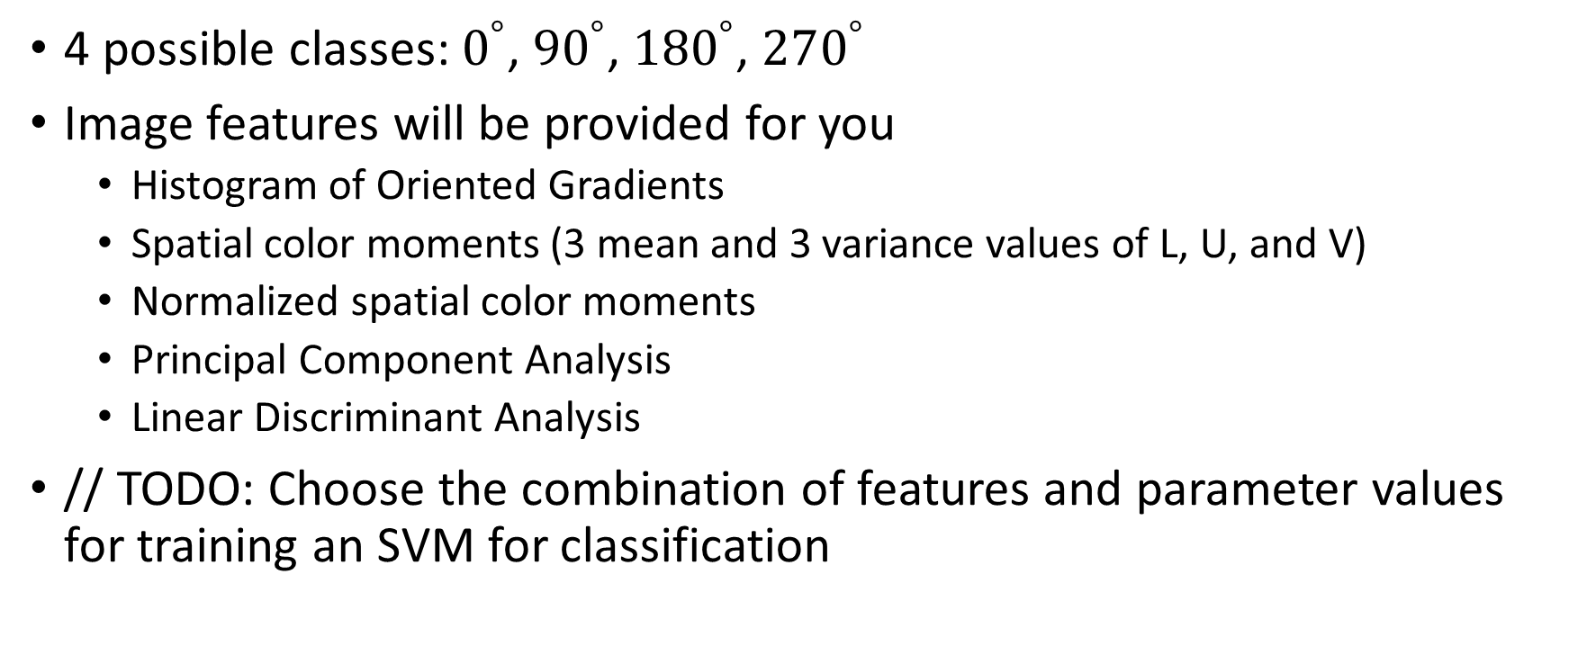
Tonight’s Task: Image Orientation Detection
4 possible classes: $0^{°}$, ${90}^{°}$, ${180}^{°}$, $270^{°}$
Image features will be provided for you
Histogram of Oriented Gradients
Spatial color moments (3 mean and 3 variance values of L, U, and V)
Normalized spatial color moments
Principal Component Analysis
Linear Discriminant Analysis
// TODO: Choose the combination of features and parameter values for training an SVM for classification

Slide 4
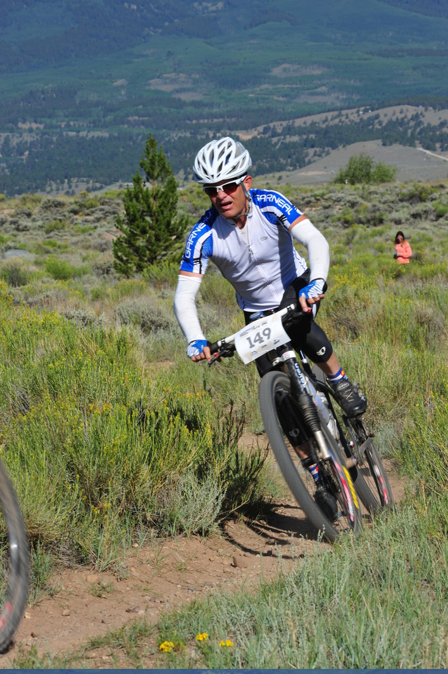

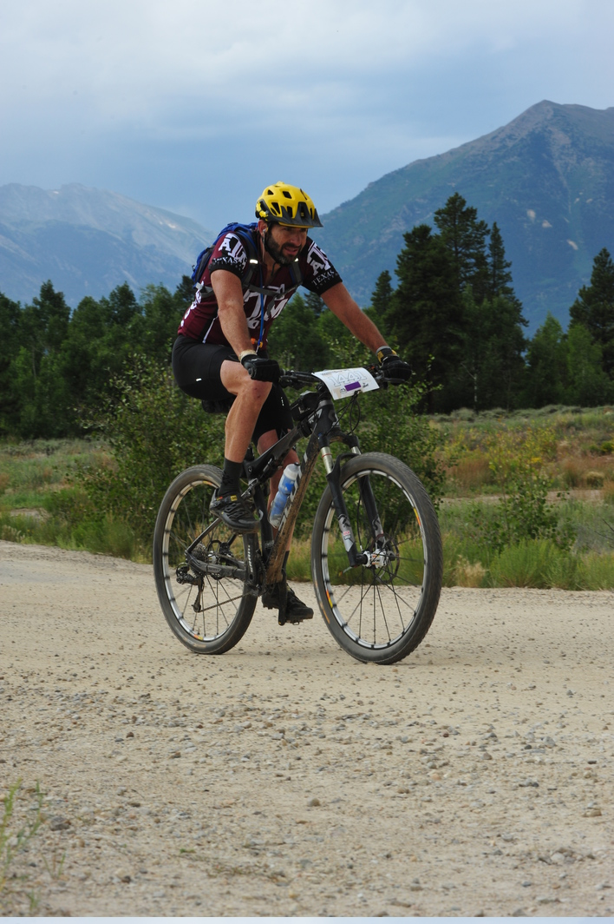

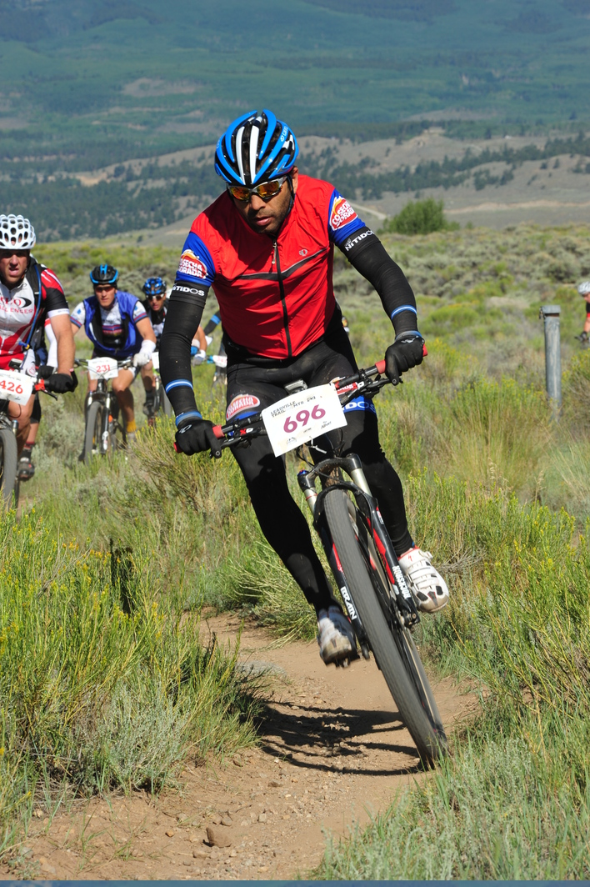



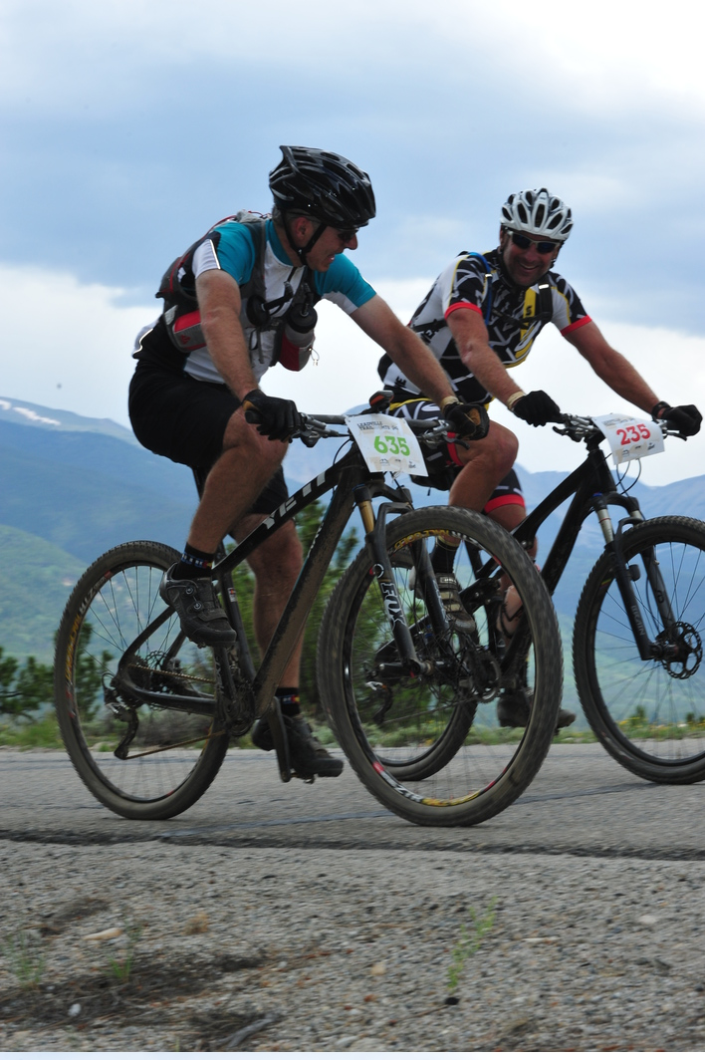
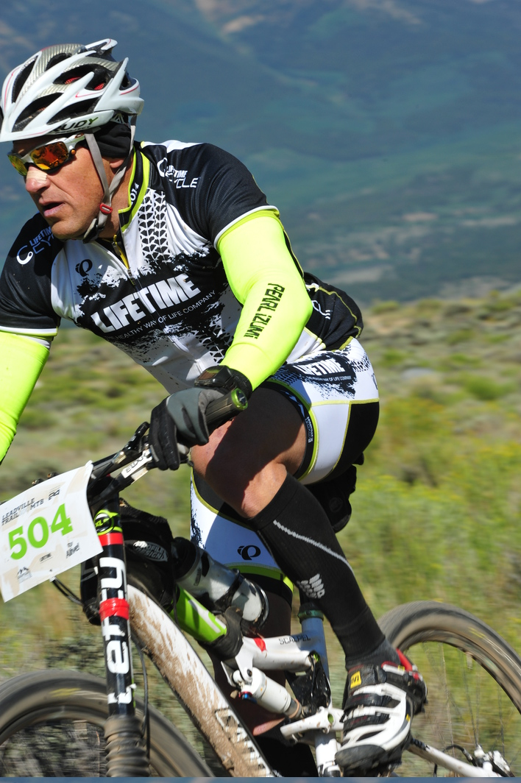

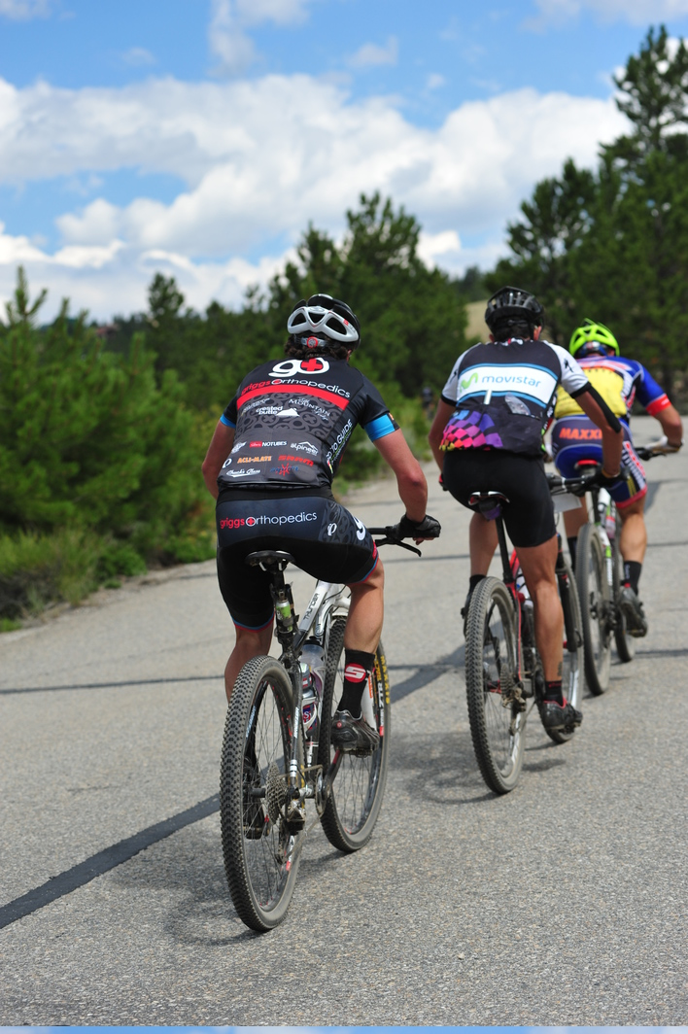
Training Data: 2149 images of people on bikes

Slide 5
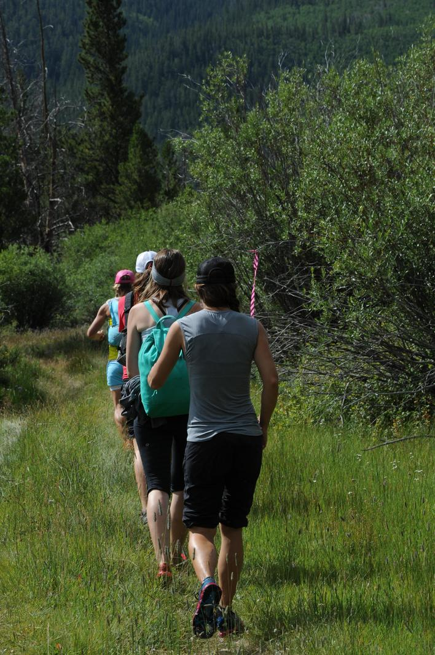
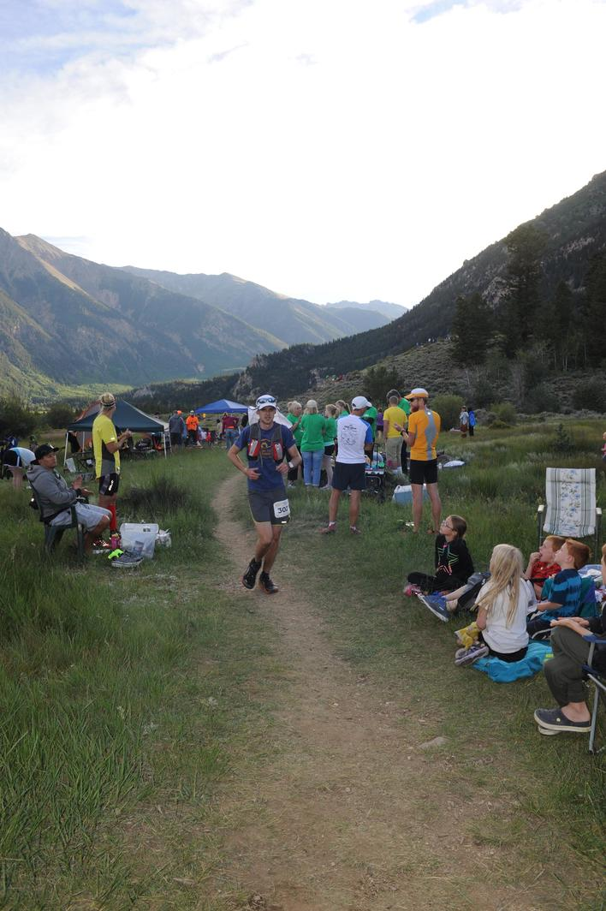


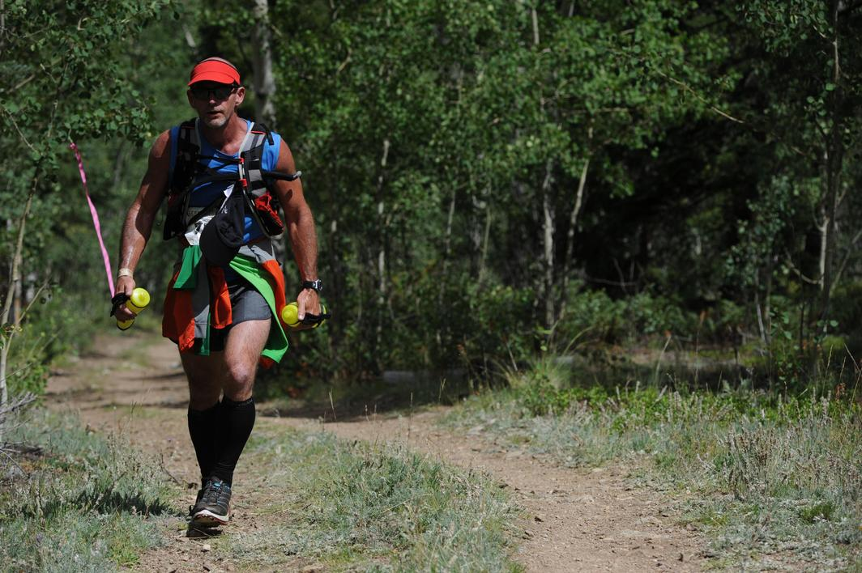
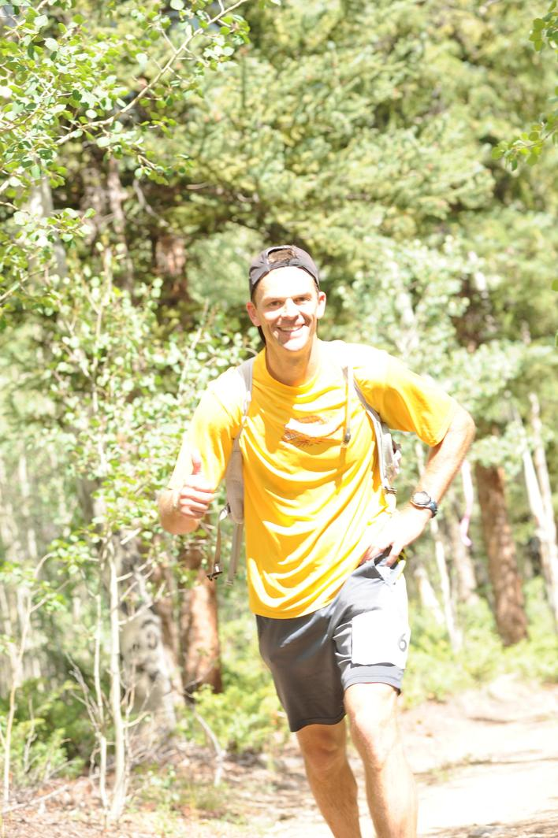

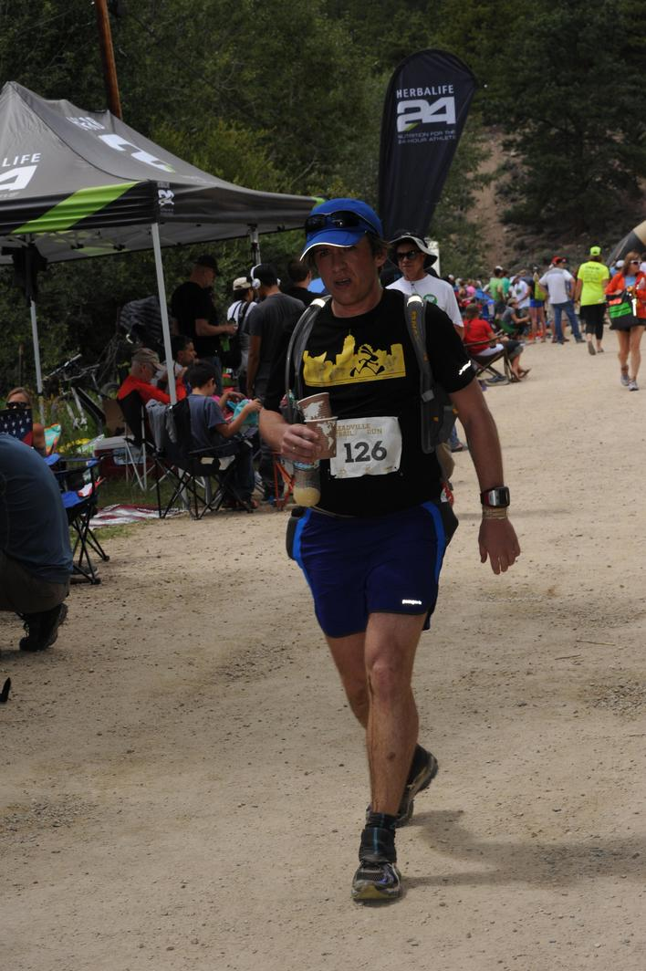
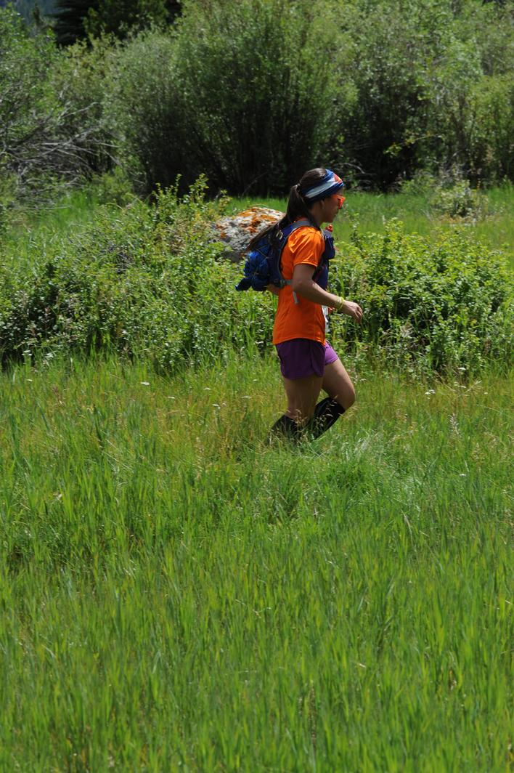
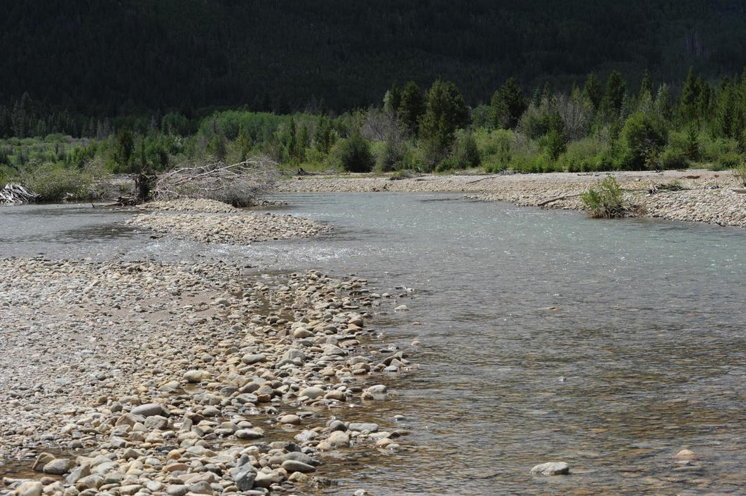
Testing Data: 626 images of people running

Slide 6
Tonight’s Task: What’s included?
Training and Test data (raw): /train/all and /test/all
Python code: function_list.py and student.py
Random assignment and rotation of training and test images with extracted features:
/img_idx/trainingdata.pckl and /img_idx/testingdata.pckl – image indices
/features/trainingdata_*_8x8.pckl – training data features
/features/testingdata_*_8x8.pckl – testing data features
Conference and journal papers which concern image orientation detection: /papers/*.pdf
An overview SVMs & the feature extraction approaches: /ppt/features.pptx

Slide 7
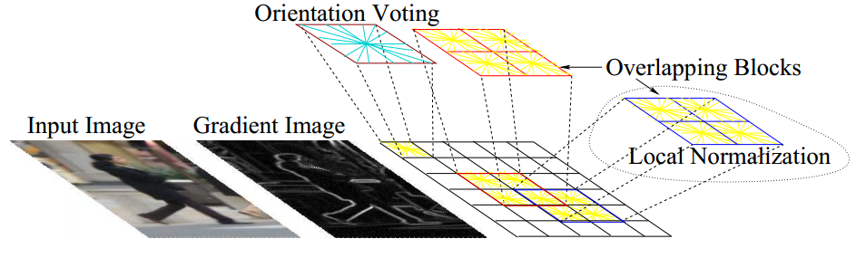
Overview: Histogram of Oriented Gradients
Normalize gamma
Compute gradients
Weighted vote into spatial & orientation cells
Normalize contrast over overlapping spatial blocks
Compute HOGs over detection Window
Input Image
Preprocessing
Similar to SIFT
Adjust for local gradient variations
Image from Dalal and Triggs

Slide 8
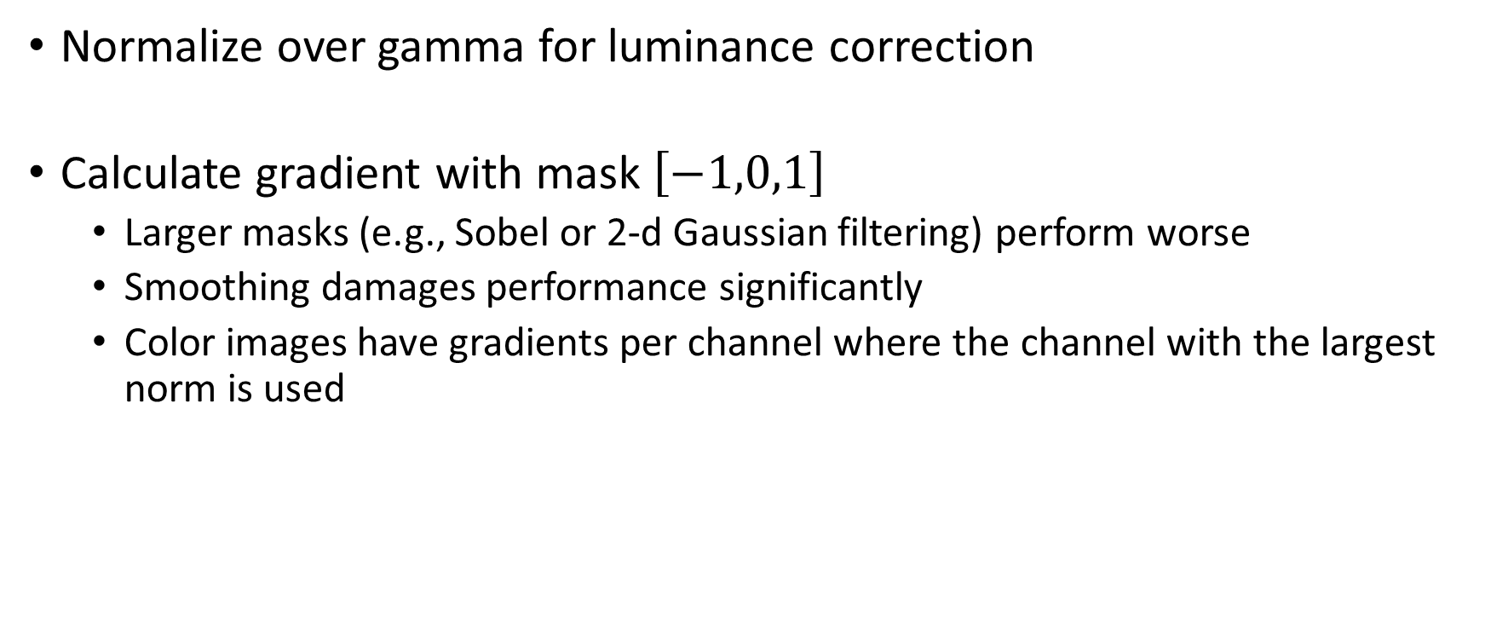
HOG Preprocessing
Normalize over gamma for luminance correction
Calculate gradient with mask $\left[−1,0,1\right]$
Larger masks (e.g., Sobel or 2-d Gaussian filtering) perform worse
Smoothing damages performance significantly
Color images have gradients per channel where the channel with the largest norm is used

Slide 9
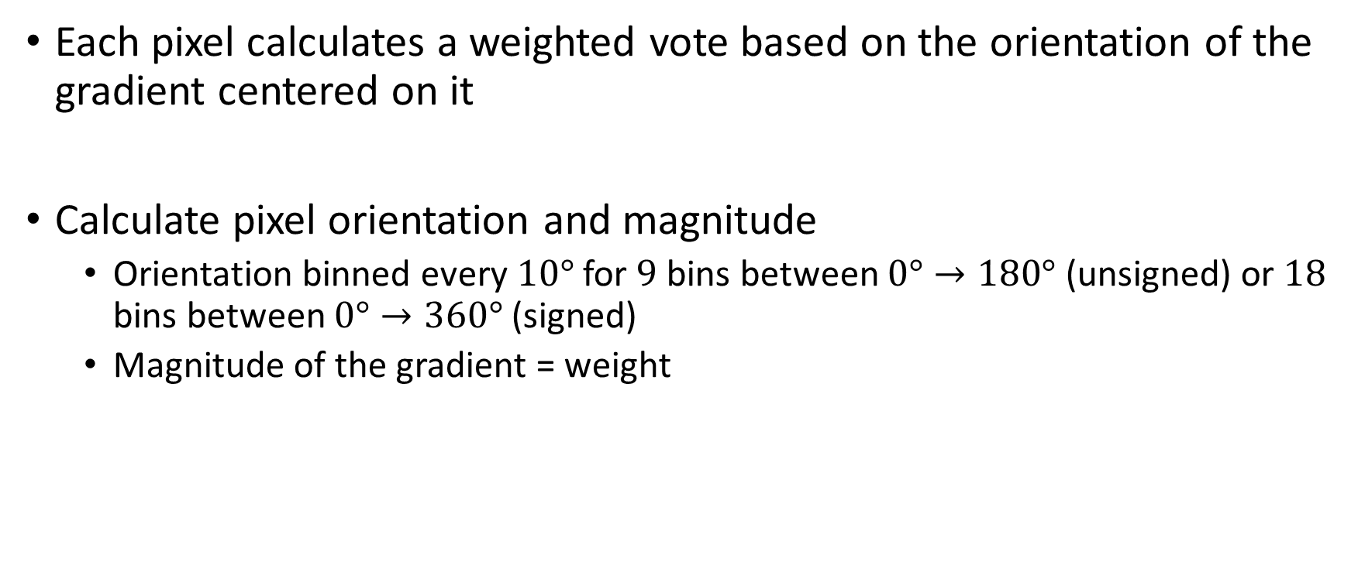
HOG Spatial and Orientation Cells
Each pixel calculates a weighted vote based on the orientation of the gradient centered on it
Calculate pixel orientation and magnitude
Orientation binned every $10°$ for $9$ bins between $0°→180°$ (unsigned) or $18$ bins between $0°→360°$ (signed)
Magnitude of the gradient = weight

Slide 10
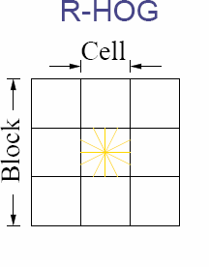
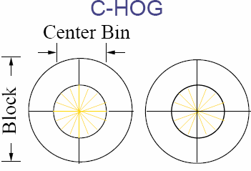




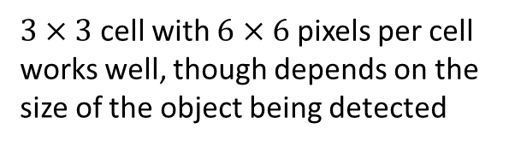
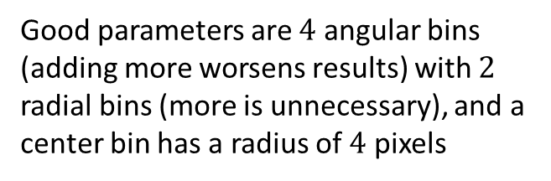
HOG Contrast Normalization
Angular bins
Radial bins
$3×3$ cell with $6×6$ pixels per cell works well, though depends on the size of the object being detected
Good parameters are $4$ angular bins (adding more worsens results) with $2$ radial bins (more is unnecessary), and a center bin has a radius of $4$ pixels
Normalization

Slide 11
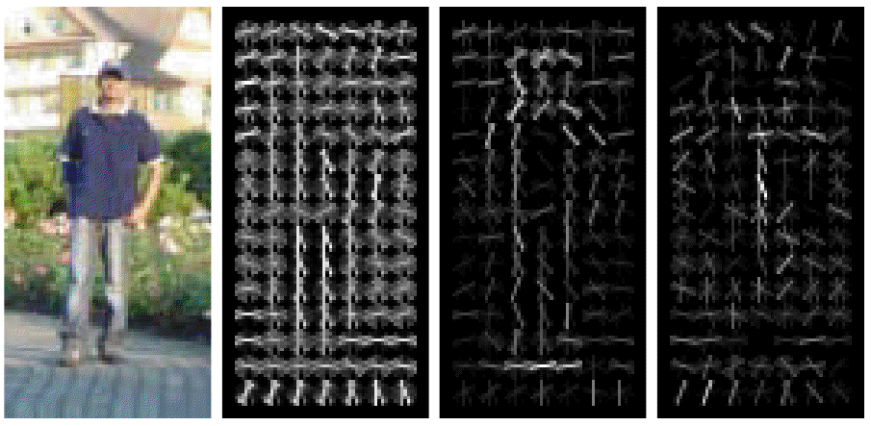
HOG Example
Image
R-HOG descriptor
Positive SVM weights
Negative SVM weights

Slide 12

Overview: Spatial Color Moments
Divide into blocks
Compute mean and variance of the pixel values within each block for each color channel
Concatenate all mean and variance values into a vector

Slide 13
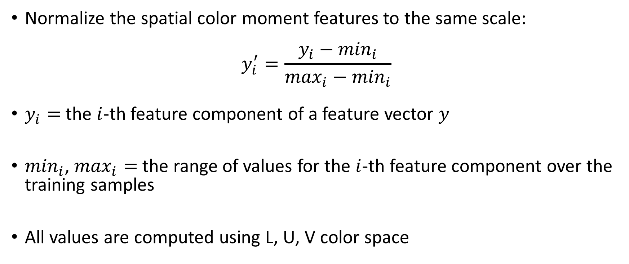
Overview: Normalized Spatial Color Moments
Normalize the spatial color moment features to the same scale:
$$y_{i}^{′}=\frac{y_{i}−\min_{i}}{\max_{i}−\min_{i}}$$
$y_{i}=$ the $i$-th feature component of a feature vector $y$
$\min_{i}$, $\max_{i}=$ the range of values for the $i$-th feature component over the training samples
All values are computed using L, U, V color space

Slide 14
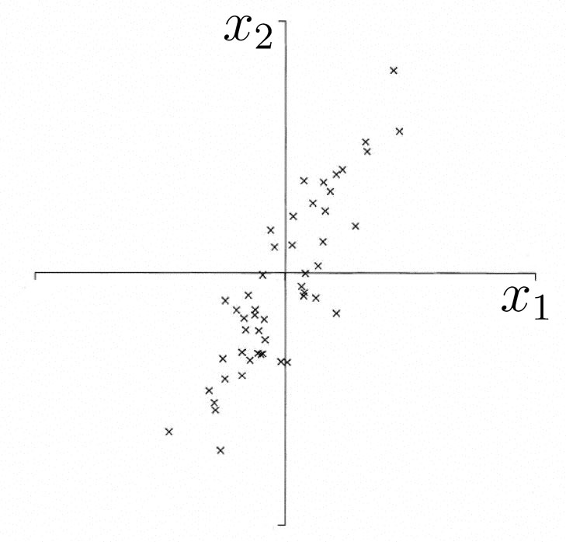
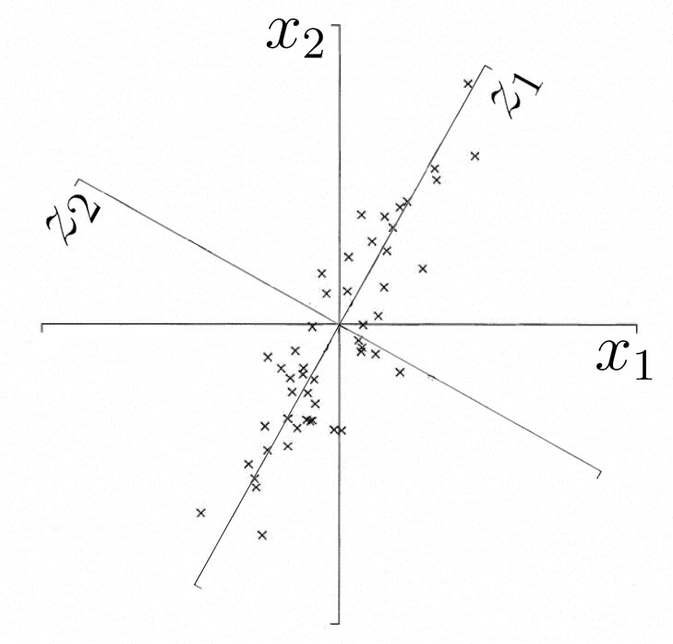
Overview: Principal Component Analysis
Multivariate statistical procedure explaining covariance structure of a set of variables via small number of their linear combinations.
Determine axis with greatest variation for a given data set.
Final coordinate system best represents the variance.

Slide 15
PCA
Algebra – Principal components are particular linear combinations of original variables, forming projection that best represents the data with low MSE
Geometry – Linear combinations represent new coordinate system (via translations and rotations). New axes can determine directions of max variability of data set.
Computational – Principal components found by calculating eigenvectors and eigenvalues of data covariance matrix. Eigenvector with largest eigenvalue reveals the direction of greatest variation.

Slide 16
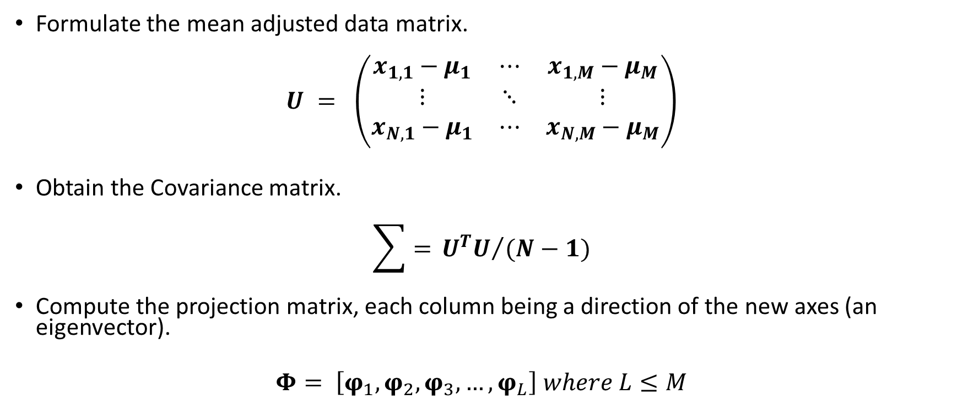
PCA
Formulate the mean adjusted data matrix.
$$U = \left(\begin{matrix}x_{1,1}−μ_{1} & ⋯ & x_{1,M}−μ_{M} \\ ⋮ & ⋱ & ⋮ \\ x_{N,1}−μ_{1} & ⋯ & x_{N,M}−μ_{M}\end{matrix}\right)$$
Obtain the Covariance matrix.
$$\sum{= }{U^{T}U}/{(N−1)}$$
Compute the projection matrix, each column being a direction of the new axes (an eigenvector).
$Φ= \left[φ_{1},φ_{2},φ_{3},…,φ_{L}\right] where L≤M$

Slide 17
PCA
The set of L eigenvectors of the covariance corresponds to the L largest eigenvalues that minimizes the MSE of reconstruction over all choices of an orthonormal basis of size L.
Much of the variability of data set can be accounted for in a smaller number of L principal components (pcs) as opposed to potentially large M variables.
N examples of M variables has suddenly been reduced to N examples on L pcs.

Slide 18
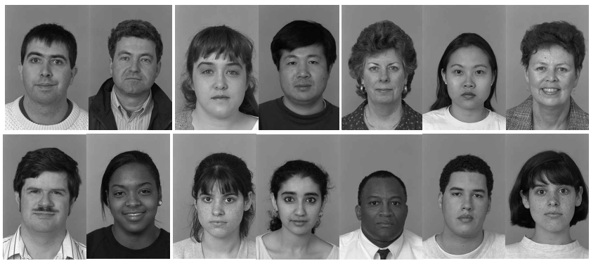
PCA Example

Slide 19
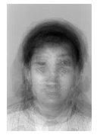
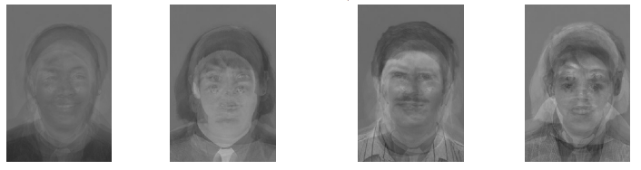
PCA Example
Our Mean Image:
Eigenvectors (also known as eigenfaces):

Slide 20
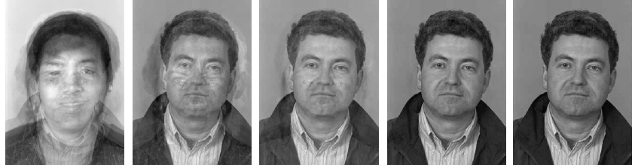
PCA Example
Reconstruct an Image from eigen-basis

Slide 21
PCA Summary
Use eigenvectors of covariance matrix with largest eigenvalues – projects across dimensions of maximum variance
Is a linear transform of high dimensional data to a lower dimension whose components are uncorrelated (if data is Gaussian, uncorrelated implies statistical independence)
Is optimal when the you want to minimize the approximated mean square error of the projection

Slide 22
PCA Summary
Works well if the data points are distributed throughout the hyperplane
Does not necessarily lead to good class separability – no guarantee that the components will be discriminable features
Will fail if data is highly non-linear or lies on more complicated manifolds

Slide 23
Overview: Linear Discriminant Analysis
Statistical pattern recognition technique.
Separates data into discrete groups via transformation into a space that maximizes ‘between-class’ separation while minimizing their ‘with-in class’ variability.
Looks for a projection where new directions maximally separate data.

Slide 24
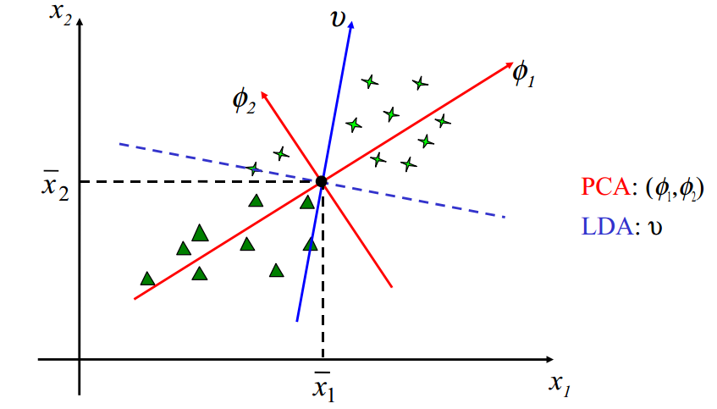
LDA Geometric View

Slide 25
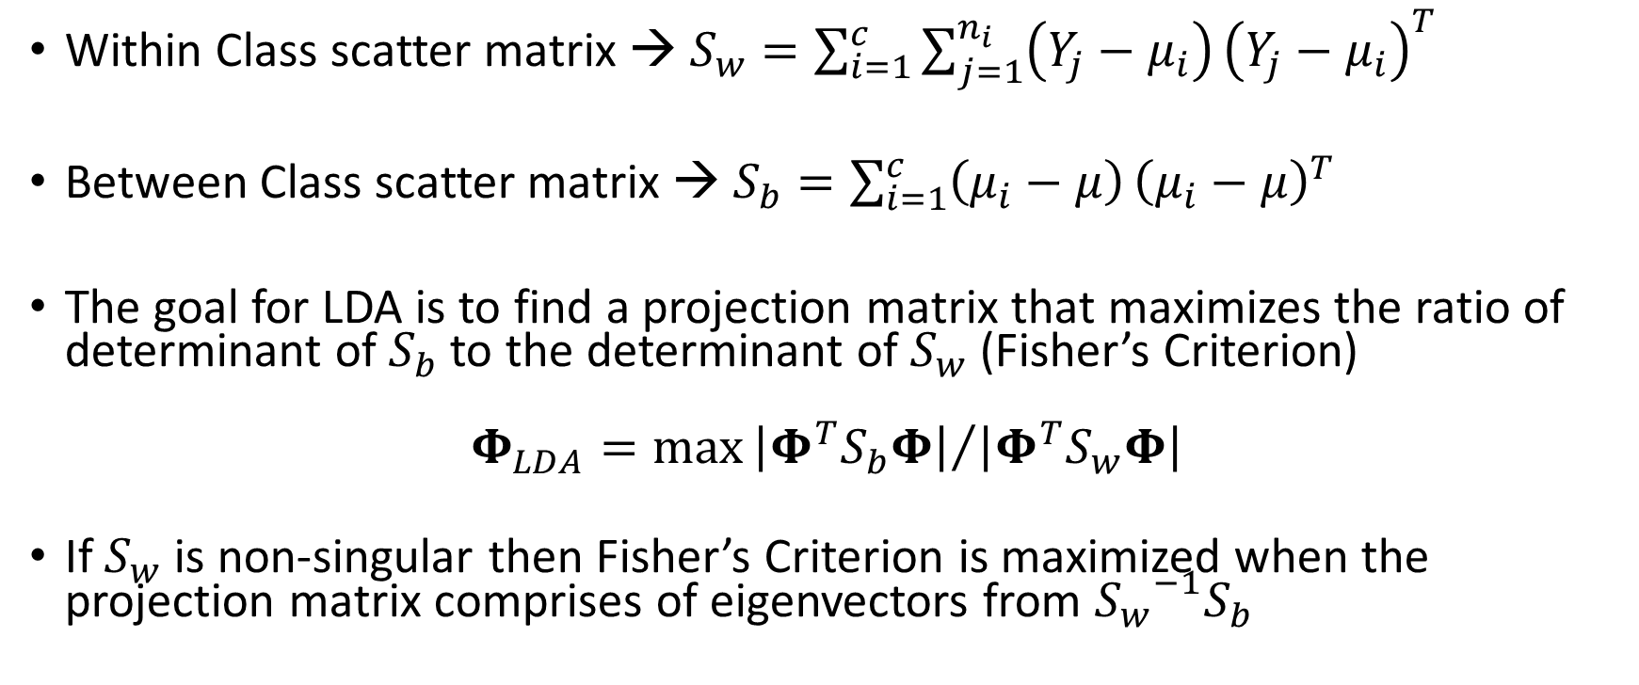
LDA
Within Class scatter matrix → $S_{w}=\sum_{i=1}^{c}{\sum_{j=1}^{n_{i}}{\left(Y_{j}−μ_{i}\right)}{\left(Y_{j}−μ_{i}\right)}^{T}}$
Between Class scatter matrix → $S_{b}=\sum_{i=1}^{c}{\left(μ_{i}−μ\right)}{\left(μ_{i}−μ\right)}^{T}$
The goal for LDA is to find a projection matrix that maximizes the ratio of determinant of $S_{b}$ to the determinant of $S_{w}$ (Fisher’s Criterion)
$$Φ_{LDA}=\max{{\left|Φ^{T}S_{b}Φ\right|}/{\left|Φ^{T}S_{w}Φ\right|}}$$
If $S_{w}$ is non-singular then Fisher’s Criterion is maximized when the projection matrix comprises of eigenvectors from ${S_{w}}^{−1}S_{b}$

Slide 26
LDA Summary
LDA is a statistical pattern recognition technique for separating samples into discrete groups.
LDA looks for directions that are efficient for discriminating data whereas PCA looks for data that are efficient for representing data.

